Slide 1
Movie recommendation system
Group2-Pandas and Chill
Pelly Kagwe
James Owiti
Amos Obaga
Nancy Muriithi
Sheilla Kavinya
5/02/2026

Slide 2
STAKE HOLDERS
Product managers at a movie streaming platform who want to improve user engagement
-Marketing and content teams who want insights into user preferences
-End users, who benefit from personalized and relevant movie suggestions

Slide 3
Flow of work
Business understanding
Data Preparation
Modeling
Evaluation
Deployment
Iterative improvement and continuous learning

Slide 4
Business Understanding
Movie streaming platforms rely heavily on personalized recommendations to keep users engaged and satisfied. With thousands of movies available, users can easily feel overwhelmed by choice, which may reduce engagement and retention. A recommendation system helps surface relevant content to users based on their past behavior, improving user experience and increasing time spent on the platform.
Low engagement and poor targeting reduce revenue
Goal: personalize offers using transaction history

Slide 5
PROBLEM STATEMENT
Platforms lack a personalized system to recommend movies to users, making it difficult to match content with individual preferences. There is a need to leverage historical user ratings to learn preference patterns and generate accurate top-5 movie recommendations for each user.

Slide 6
Objectives
An automated system to predict preferences
Objectives:
Reduce 25% user churn through personalized recommendations
Decrease browsing time from 20+ minutes to under 5 minutes
Increase user engagement and monthly watch time by 30%

Slide 7
Data Understanding
Environmental setup and library installation
Pickied dataset
Inspected shape, columns, summary statistics
Checked nulls, duplicates, uniformity, outliers

Slide 8
DATA ACQUISITION
Used MobieLens directly form GroupLens Research Lab
WHY?
Industry-standard benchmark for recommendation systems
Explicit ratings provide clear feedback signal
Realistic sparsity (98.3%) reflects real-world scenarios
Appropriate size for local computation without cloud infrastructure

Slide 9
Data Preparation
Loaded datasets –three major ones
Inspecting – Data type and structure, missing values, basic statistics, relationships between files
Data quality assessment – Missing values, duplicates
Matrix sparsity analysis- Sparsity measures how many potential user-movie pairs have NO rating.

Slide 10
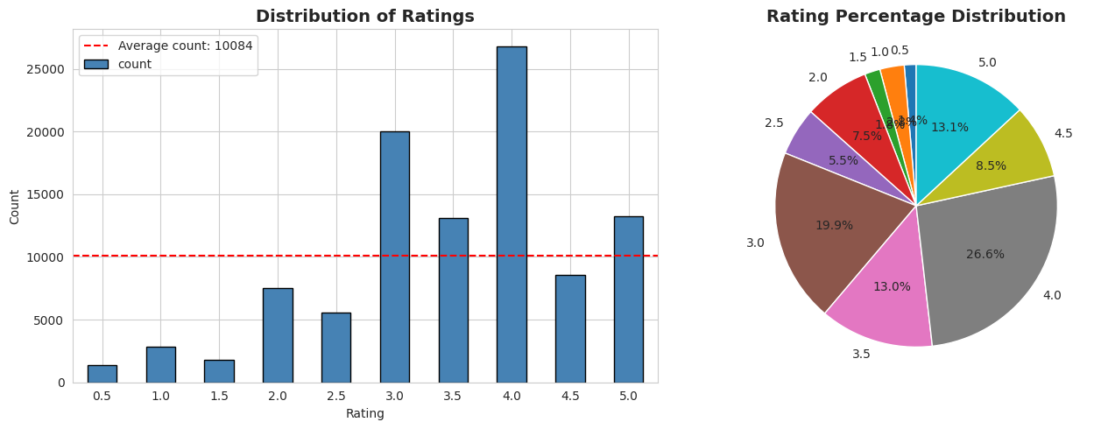
EDA – Rating Distribution
Most ratings cluster between 3–4
Shows positive user sentiment
Supports collaborative filtering assumptions

Slide 11
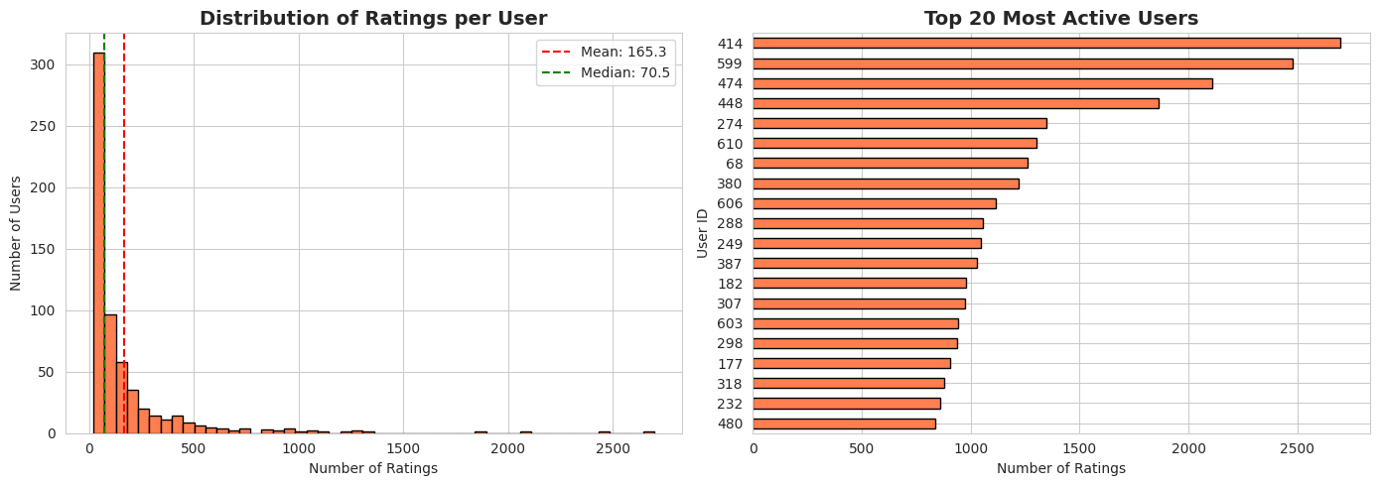
EDA – Understanding user engagement patterns
Average ratings per user
Median ratings per user
Distribution- are users equally engages or high variable

Slide 12
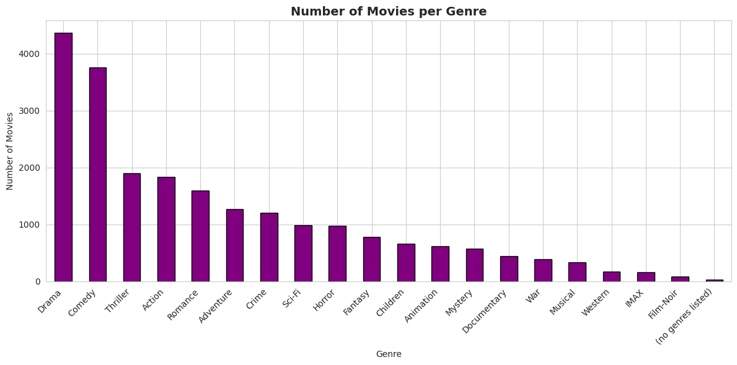
EDA- GENRE DISTRIBUTION ANALYSIS
Understand genre composition of our movie catalog.
It reveals content diversity in our dataset
Can inform content based filtering

Slide 13
Data preparation for modeling
Create user-item rating matrix
Build baseline models (global avg, user avg)
Implement collaborative filtering with cosine similarity
Generate top-5 recommendations
Train-test split strategy
Create training matrix

Slide 14
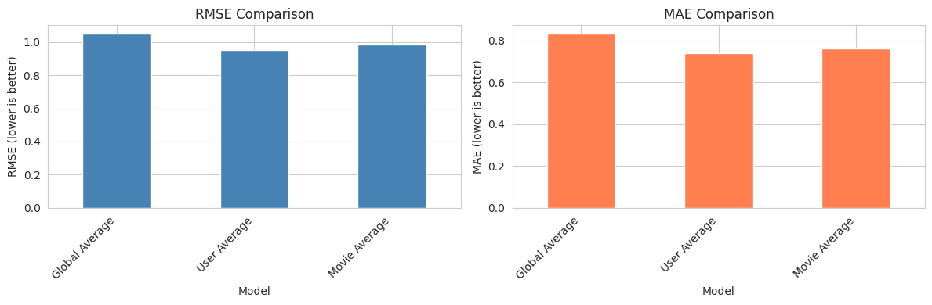
mOdels
Model 1- global average
Model 2- user average
Model 3- Movie average
How to pick best mode- RMSE, MAE

Slide 15
COLLABORATIVE FILTERING
Done using cosine similarity.
User-Based CF:
Find users similar to target user (using cosine similarity)
Weight their ratings by similarity
Predict rating = weighted average of similar users' ratings
Item-Based CF:
Find movies similar to movies the user rated
Weight by similarity
Predict rating = weighted average

Slide 16
Top 5 recommendation system
Using the best model to generate movie recommendations.
For Each User, We Show:
User Statistics:
  Total movies rated
  Average rating (harsh critic or generous rater?)
User's Favorites (rating ≥ 4.0):
  Shows what user already likes
  Helps us validate if recommendations make sense
Top-5 Recommendations:
  Personalized movie suggestions
  Predicted ratings (how confident we are)

Slide 17
CONCLUSION & BUSINESS RECCOMENDATION
Business Impact:
Successfully generates personalized top-5 recommendations
Scalable to CineStream's 50,000+ user base
Addresses key business problems:
  Reduces browsing time (targeted suggestions)
  Increases engagement (personalized experience)
  Improves retention (users find content they love)

Slide 18
THANK YOU
FEEL FREE TO ASK ANY QUESTONS!

